Slide 1
Lecture 20: Clustering (Part 1)
Instructor: Yang Xu

Slide 2
Outline
K-means
Hierarchical clustering
Density-based clustering (DBScan)

Slide 3
Supervised learning
We know what the correct label is for each training example

Slide 4
Unsupervised learning
We don’t know the label
The job is to automatically discover pattern and structure in data
E.g., find the clusters

Slide 5
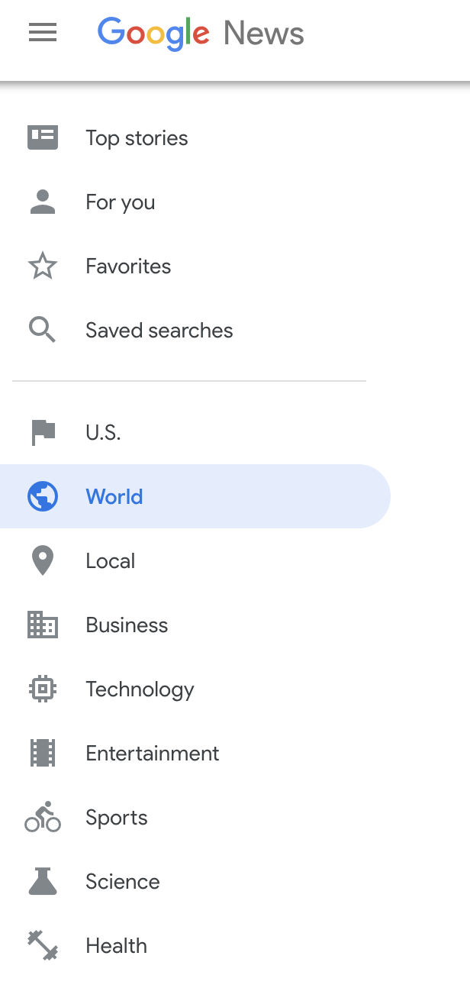
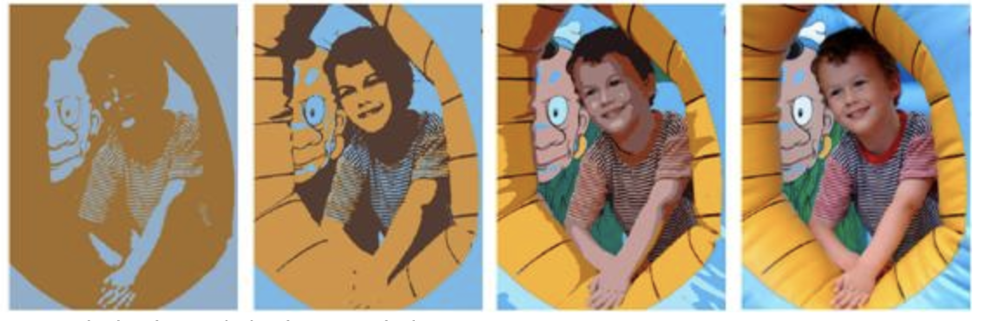
Real world clustering example
http://news.google.com/: text clustering
Image segmentation

Slide 6
K-means clustering algorithm
Term first used by James MacQueen, 1967
Algorithm proposed by Stuart Lloyd, 1957, published in 1982.

Slide 7
K-means clustering algorithm
Goal: Assign all data points to 2 clusters
Step 1: Pick 2 random initial cluster centroids
Step 2: Paint the data points that are closer to red centroid red, and those closer to blue centroid blue

Slide 8
K-means clustering algorithm
Goal: Assign all data points to 2 clusters
Step 1: Pick 2 random initial cluster centroids
Step 2: Paint the data points that are closer to red centroid red, and those closer to blue centroid blue
Step 3: Update the positions of centroids
Red centroid := average of current red points
Blue centroid := average of current blue points

Slide 9
K-means clustering algorithm
Goal: Assign all data points to 2 clusters
Step 1: Pick 2 random initial cluster centroids
Step 2: Paint the data points that are closer to red centroid red, and those closer to blue centroid blue
Step 3: Update the positions of centroids
Red centroid := average of current red points
Blue centroid := average of current blue points
Repeat

Slide 10
K-means clustering algorithm
Goal: Assign all data points to 2 clusters
Step 1: Pick 2 random initial cluster centroids
Step 2: Paint the data points that are closer to red centroid red, and those closer to blue centroid blue
Step 3: Update the positions of centroids
Red centroid := average of current red points
Blue centroid := average of current blue points
Repeat

Slide 11
K-means clustering algorithm
Goal: Assign all data points to 2 clusters
Step 1: Pick 2 random initial cluster centroids
Step 2: Paint the data points that are closer to red centroid red, and those closer to blue centroid blue
Step 3: Update the positions of centroids
Red centroid := average of current red points
Blue centroid := average of current blue points
Repeat

Slide 12
K-means clustering algorithm
Goal: Assign all data points to 2 clusters
Step 1: Pick 2 random initial cluster centroids
Step 2: Paint the data points that are closer to red centroid red, and those closer to blue centroid blue
Step 3: Update the positions of centroids
Red centroid := average of current red points
Blue centroid := average of current blue points
Repeat

Slide 13
K-means clustering algorithm
Goal: Assign all data points to 2 clusters
Step 1: Pick 2 random initial cluster centroids
Step 2: Paint the data points that are closer to red centroid red, and those closer to blue centroid blue
Step 3: Update the positions of centroids
Red centroid := average of current red points
Blue centroid := average of current blue points
Repeat
Until no more pointes need to be repainted, i.e., the centroids no longer change
Clustering is done

Slide 14
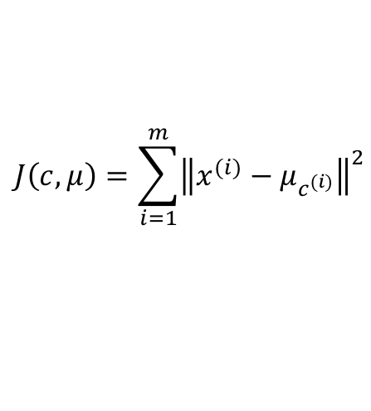
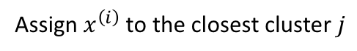
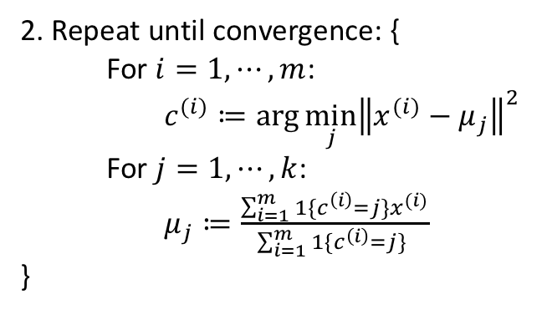
K-means formal definition
Given a dataset $\{x^{\left(1\right)},⋯,x^{\left(m\right)}\}$, $x^{\left(i\right)}∈ℝ^{n}$, and want to group the data into $k$ clusters
1. Initialize $k$ cluster centroids $μ_{1},μ_{2},⋯,μ_{k}∈ℝ^{n}$ randomly
2. Repeat until convergence: {
For $i=1,⋯,m$:
$c^{(i)}≔\arg{\min_{j}{{\left\|x^{(i)}−μ_{j}\right\|}^{2}}}$
For $j=1,⋯,k$:
$μ_{j}≔\frac{\sum_{i=1}^{m}{1\{c^{\left(i\right)}=j\}x^{(i)}}}{\sum_{i=1}^{m}{1\{c^{\left(i\right)}=j\} }}$
}
Usually, Euclidean distance is the best option
Assign $x^{\left(i\right)}$ to the closest cluster $j$
Update centroid $μ_{j}$ with mean of all within-cluster data points
From a machine learning perspective, K-means minimize the cost function:
$$J\left(c,μ\right)=\sum_{i=1}^{m}{{\left\|x^{(i)}−μ_{c^{(i)}}\right\|}^{2}}$$
guaranteed to converge

Slide 15
How to initialize centroids?
Randomly pick $k$ data points as the initial centroids
Solutions:
Run multiple times with different initializations and evaluate
K-means++ (Arthur & Vassilvitskii, 2007)
Sometimes it leads to different clustering results

Slide 16
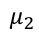
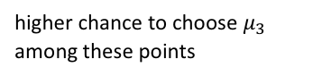
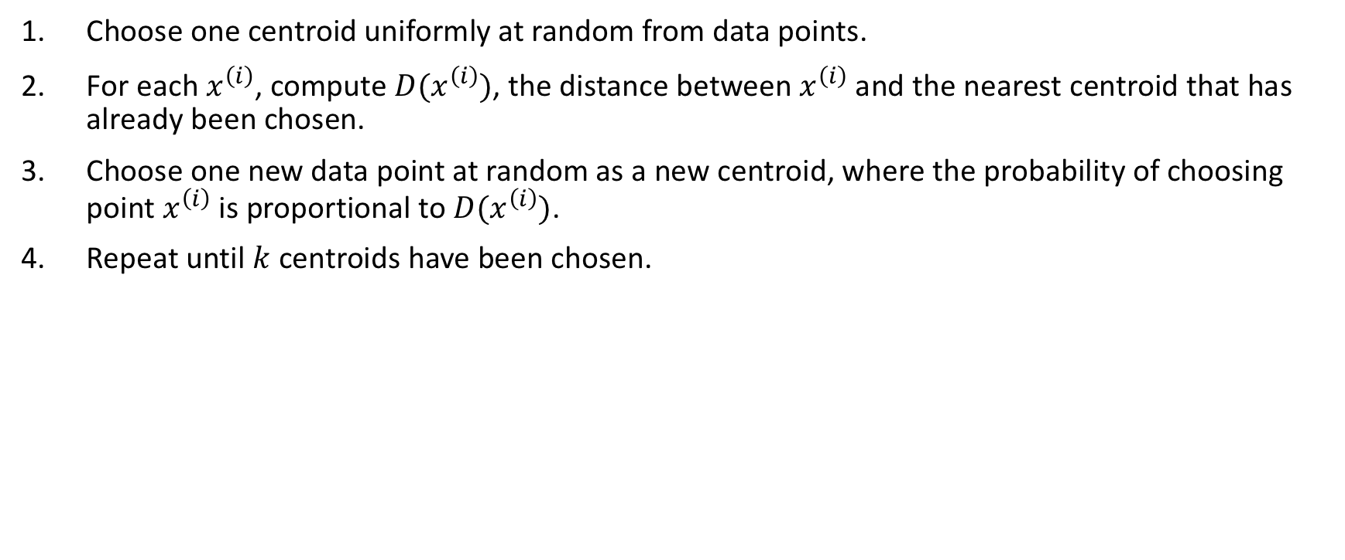
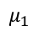
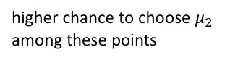
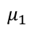
Better initialization with K-means++
Arthur & Vassilvitskii, 2007
Choose one centroid uniformly at random from data points.
For each $x^{\left(i\right)}$, compute $D(x^{\left(i\right)})$, the distance between $x^{\left(i\right)}$ and the nearest centroid that has already been chosen.
Choose one new data point at random as a new centroid, where the probability of choosing point $x^{\left(i\right)}$ is proportional to $D(x^{\left(i\right)})$.
Repeat until $k$ centroids have been chosen.
higher chance to choose $μ_{2}$ among these points
$$μ_{2}$$
$$μ_{1}$$
$$μ_{1}$$
higher chance to choose $μ_{3}$ among these points

Slide 17
How to choose K?
By intuitive observation
Better use one cluster
Better use two clusters
Is there a systematic evaluation?

Slide 18
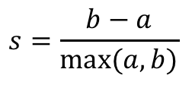
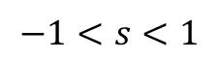
Evaluate clustering result
high similarity within cluster
A good clustering algorithm:
low similarity between cluster
silhouette coefficient
$$s=\frac{b−a}{max⁡(a,b)}$$
$$−1<s<1$$
/ˌsilo͞oˈet/: contour, outline
$a$ is the mean distance between a data point and all other points in the same cluster
$b$ is the mean distance between a data point and all other points in the next neighbor cluster

Slide 19
Silhouette coefficient with different Ks
K=2
K=4
Image source: https://scikit-learn.org/stable/auto_examples/cluster/plot_kmeans_silhouette_analysis.html

Slide 20
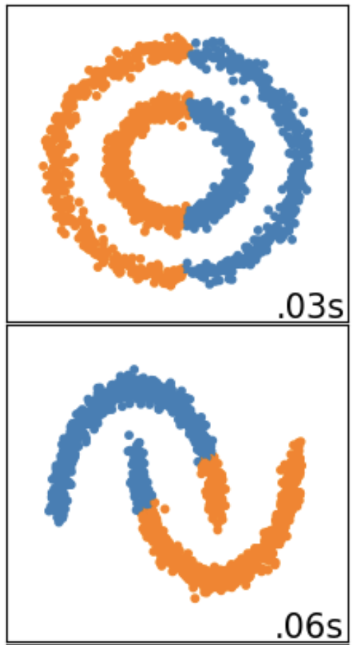
K-means: pros and cons
Pros:
Easy to implement
Scales to very large datasets
Cons:
Difficult to choose K.
Only works spherical, convex clusters.
Where K-means does not work well

Slide 21
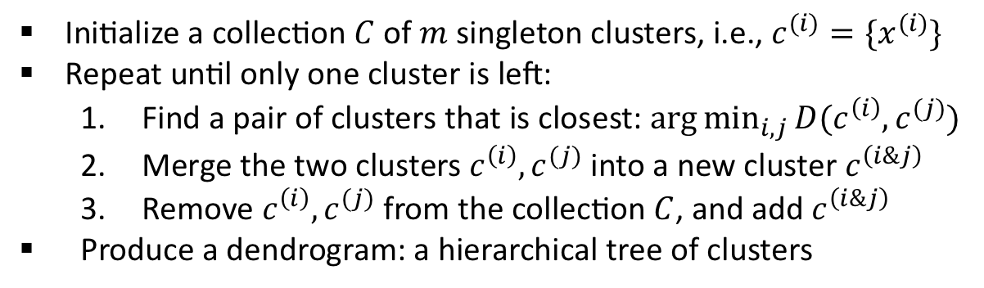
Hierarchical clustering
Idea: make sure nearby data points end up in the same cluster
Initialize a collection $C$ of $m$ singleton clusters, i.e., $c^{(i)}=\{x^{(i)}\}$
Repeat until only one cluster is left:
Find a pair of clusters that is closest: $\arg{\min_{i,j}{D(c^{\left(i\right)},c^{(j)})}}$
Merge the two clusters $c^{\left(i\right)},c^{(j)}$ into a new cluster $c^{\left(i\&j\right)}$
Remove $c^{\left(i\right)},c^{(j)}$ from the collection $C$, and add $c^{\left(i\&j\right)}$
Produce a dendrogram: a hierarchical tree of clusters
Need to define a distance metric

Slide 22
Hierarchical clustering example
M
L
N
E
A
B
F
G
Dendrogram
K
D
C
Distance
H
I
threshold
J
A
B
C
D
E
F
G
H
I
J
K
L
M
N

Slide 23
Hierarchical clustering example
M
L
N
In this example, distance between clusters is defined by the closest pair
E
A
B
F
G
Dendrogram
K
D
C
threshold
H
I
Distance
J
A
B
C
D
E
F
G
H
I
J
K
L
M
N

Slide 24
Hierarchical clustering example
M
L
N
E
A
B
F
G
Dendrogram
K
D
C
Distance
H
I
J
threshold
A
B
C
D
E
F
G
H
I
J
K
L
M
N

Slide 25
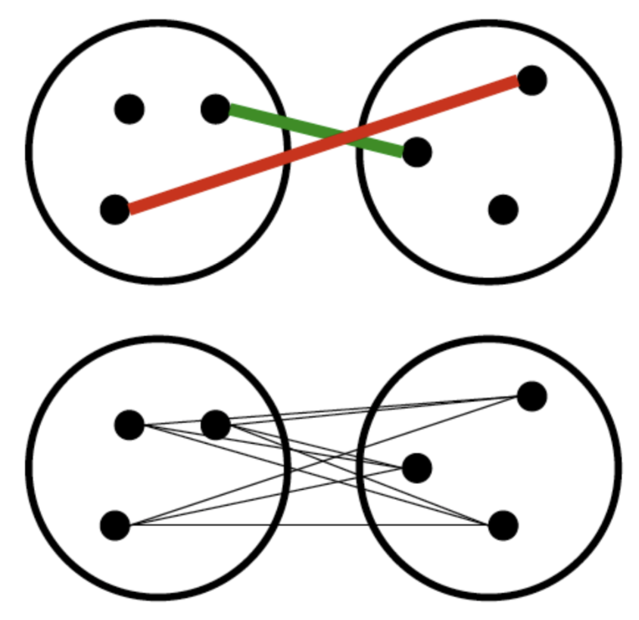
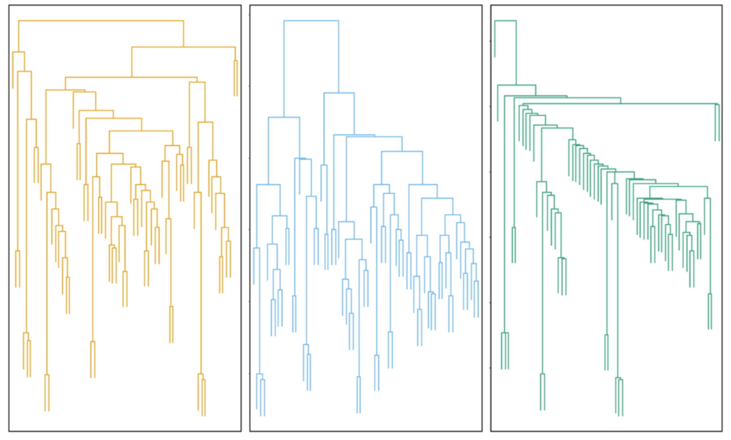
Hierarchical clustering
Distance options:
closest pair, farthest pair, or average of all pairs
Distance option influences the clustering result
Average
Farthest
Closest

Slide 26
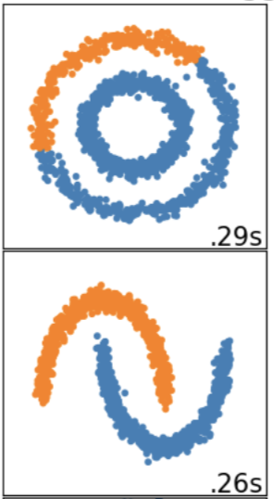
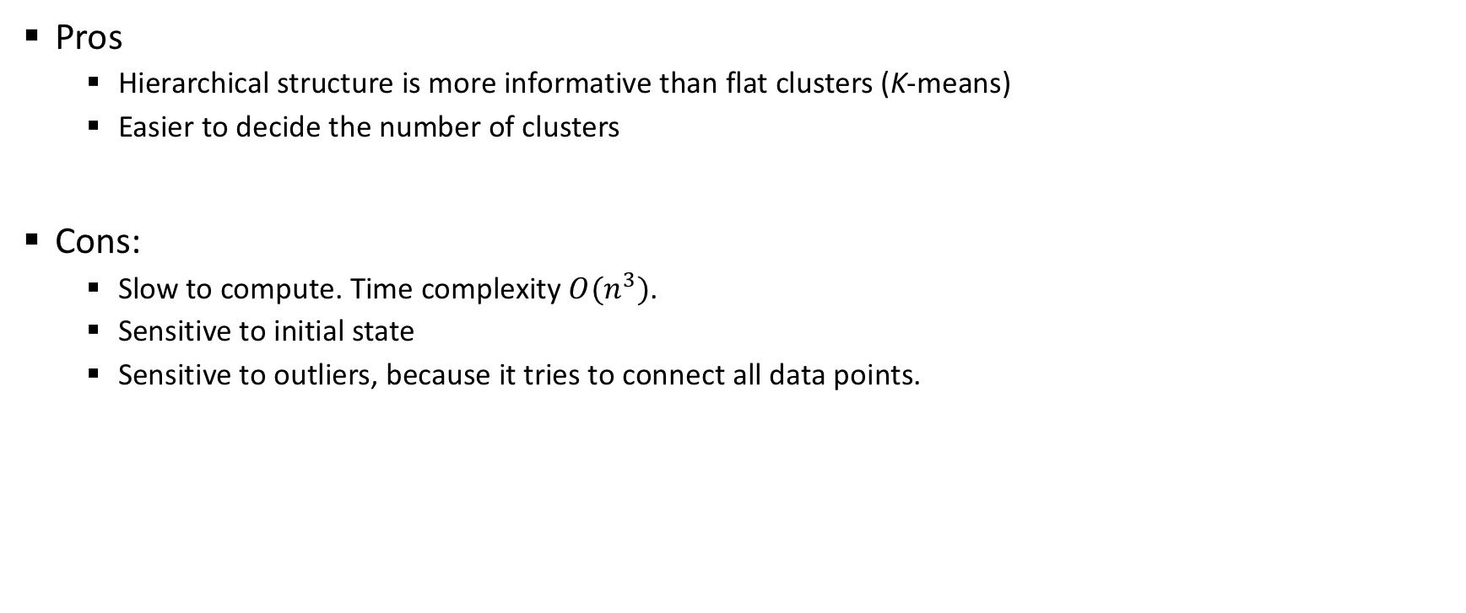
Hierarchical clustering: pros and cons
Pros
Hierarchical structure is more informative than flat clusters (K-means)
Easier to decide the number of clusters
Cons:
Slow to compute. Time complexity $O(n^{3})$.
Sensitive to initial state
Sensitive to outliers, because it tries to connect all data points.
Hierarchical clustering with Ward’s method

Slide 27
Density-based clustering
Idea: Clustering based on density (local clustering criterion), e.g., number of densely connected points.
Most well-known algorithm: DBSCAN

Slide 28
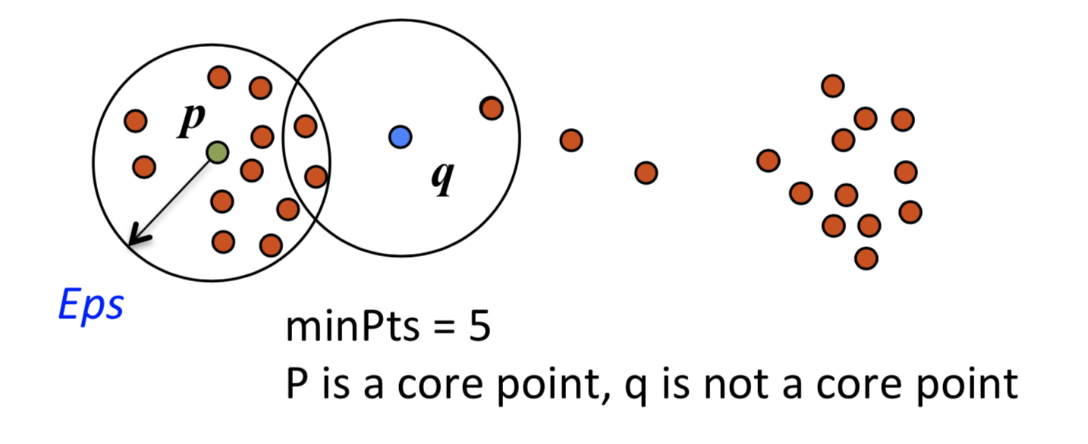
DBSCAN
Ester, et al (1996)
DBSCAN classify all points as core points, (density-)reachable points and outliers:
A point p is a core point if at least minPts points are within distance ε (ε is the maximum radius of the neighborhood from p) of it (including p)
A point q is directly reachable from p if point q is within distance ε from point p and p must be a core point.
A point q is reachable from p if there is a path p₁, ..., p_{n} with p₁ = p and p_{n} = q, where each p_{i+1} is directly reachable from p_{i} (all the points on the path must be core points, with the possible exception of q).
All points not reachable from any other point are outliers.

Slide 29
DBSCAN demo
minPts = 4
All red points are core points. Because they are reachable from one another, they form a single cluster.
Points B and C are not core points, but are reachable from A and thus belong to the cluster as well.
Point N is a noise point, because it is neither a core nor directly-reachable.
https://www.naftaliharris.com/blog/visualizing-dbscan-clustering/

Slide 30
DBSCAN steps
Find the points in the ε (eps) neighborhood of every point, and identify the core points (> minPts)
Find the connected components of core points, ignoring all non-core points.
Assign each non-core point to a nearby cluster if it is reachable, otherwise assign it to noise.

Slide 31
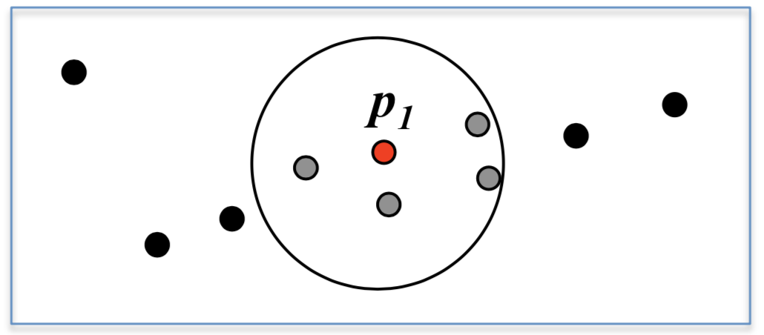
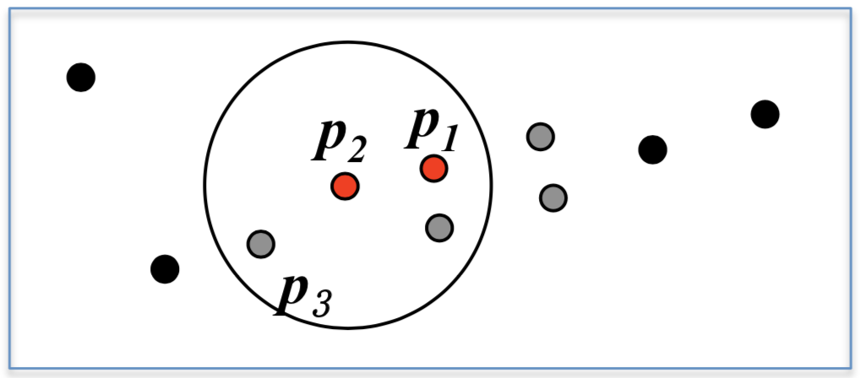
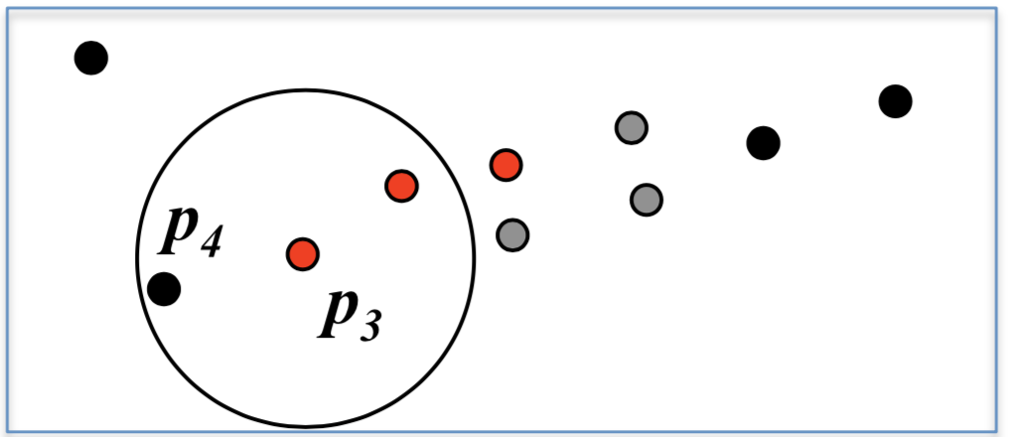
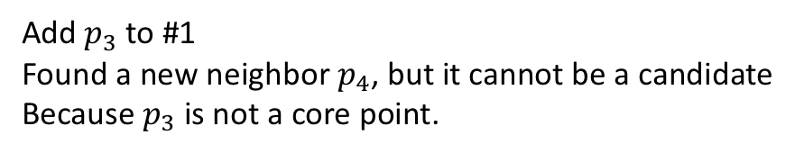
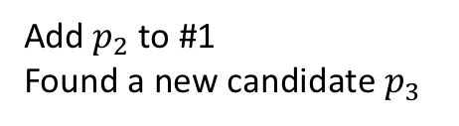
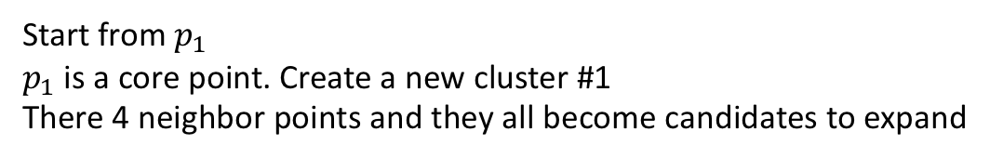
DBSCAN breakdown
minPts = 3
Start from $p_{1}$
$p_{1}$ is a core point. Create a new cluster #1
There 4 neighbor points and they all become candidates to expand
Add $p_{2}$ to #1
Found a new candidate $p_{3}$
Add $p_{3}$ to #1
Found a new neighbor $p_{4}$, but it cannot be a candidate
Because $p_{3}$ is not a core point.

Slide 32
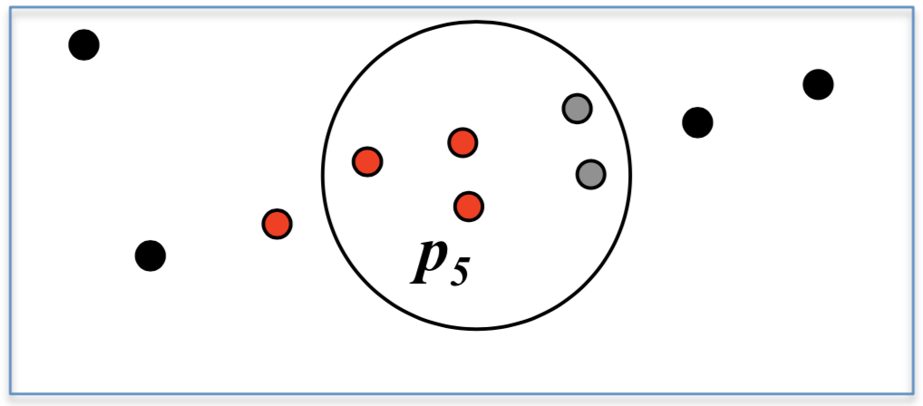
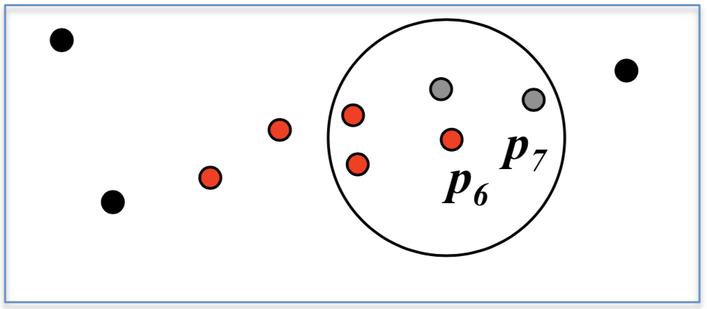
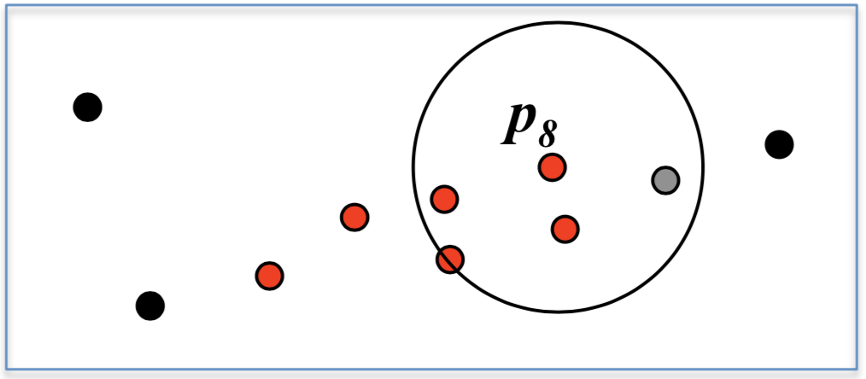
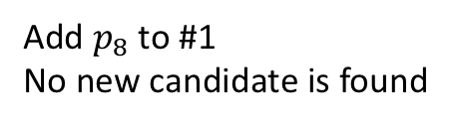
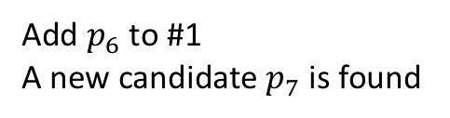
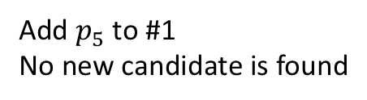
DBSCAN breakdown (cont.)
Add $p_{5}$ to #1
No new candidate is found
Add $p_{6}$ to #1
A new candidate $p_{7}$ is found
Add $p_{8}$ to #1
No new candidate is found

Slide 33
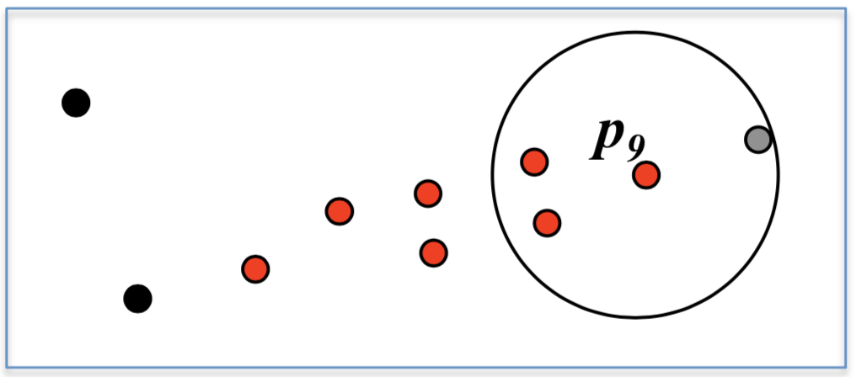
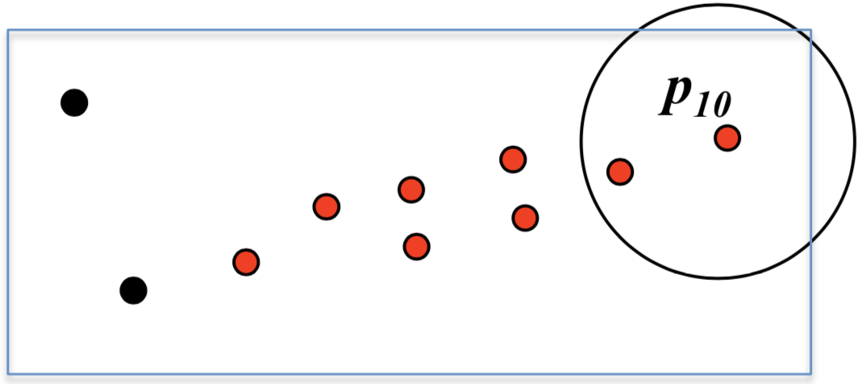
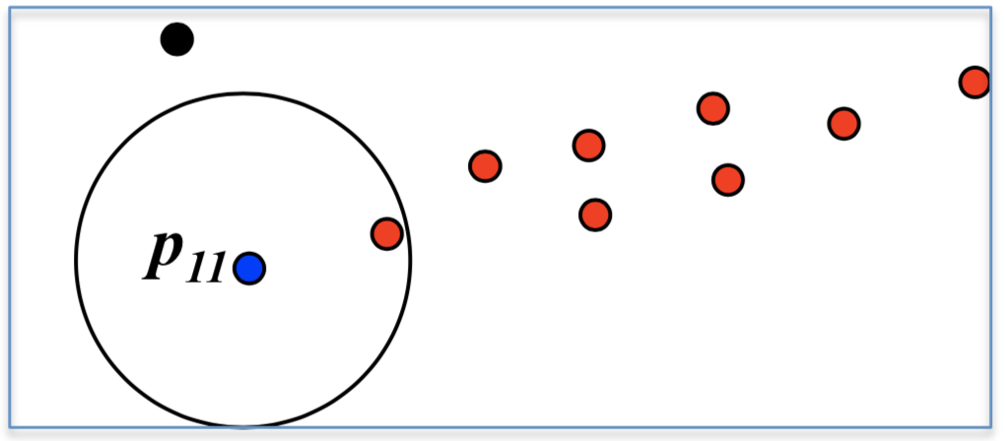
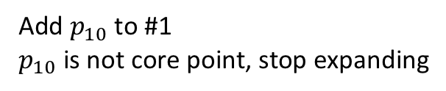
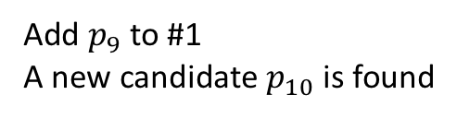
DBSCAN breakdown (cont.)
Add $p_{9}$ to #1
A new candidate $p_{10}$ is found
Add $p_{10}$ to #1
$p_{10}$ is not core point, stop expanding
Mark noise points

Slide 34
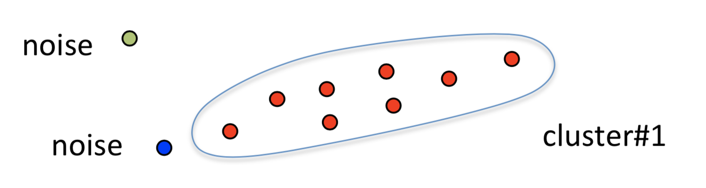
DBSCAN breakdown (cont.)
Final output

Slide 35
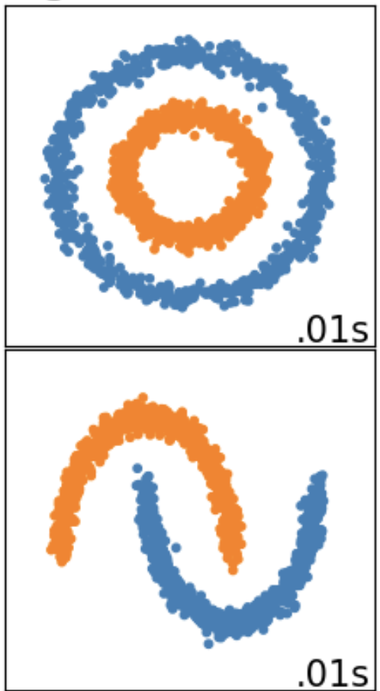
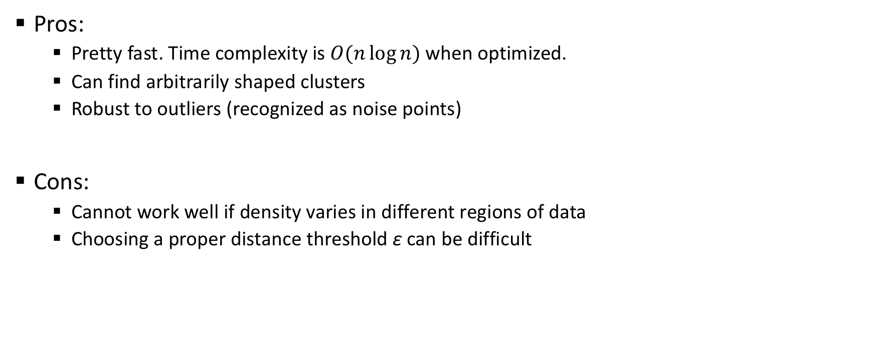
DBSCAN pros and cons
Pros:
Pretty fast. Time complexity is $O(n\log{n})$ when optimized.
Can find arbitrarily shaped clusters
Robust to outliers (recognized as noise points)
Cons:
Cannot work well if density varies in different regions of data
Choosing a proper distance threshold ε can be difficult

Slide 36
Next lecture
Mixture Gaussian Model and EM method

